Slide 1


Improving the Arrival Time Prediction of CMEs using MHD Ensemble Modeling, HI data, and Machine Learning
Talwinder Singh¹, Bernard Benson², Syed Raza³, Tae Kim¹, Nikolai Pogorelov¹
¹University of Alabama in Huntsville, AL, USA
²McLeod Software Corporation, Birmingham, AL, USA
³University of Alabama in Birmingham, AL 35294, USA

Slide 2
Table of contents
MHD simulations of flux rope-based CMEs in data driven solar wind
Constraining flux rope model with observations
Uncertainty quantification in CME fittings
Ensemble modeling of CMEs
Comparing ensembles with HI data
Improving the arrival time of CMEs by using above comparison and ML techniques
Conclusions

Slide 3
Data driven solar wind simulations
Simulations using Multi Scale Fluid Kinetic Simulation Suite (MS-FLUKSS, Pogorelov 2014).
MS-FLUKSS is used to solve ideal MHD equations in a fully spherical grid, with AMR capability.
The inner boundary is provided by semi-empirical Wang-Sheeley-Arge (WSA) corona model.
The WSA model is driven by photospheric magnetic field observations in the form of synchronic magnetograms.
This results in a time-dependent inner boundary in our inner heliosphere model.
Singh et al 2020b

Slide 4
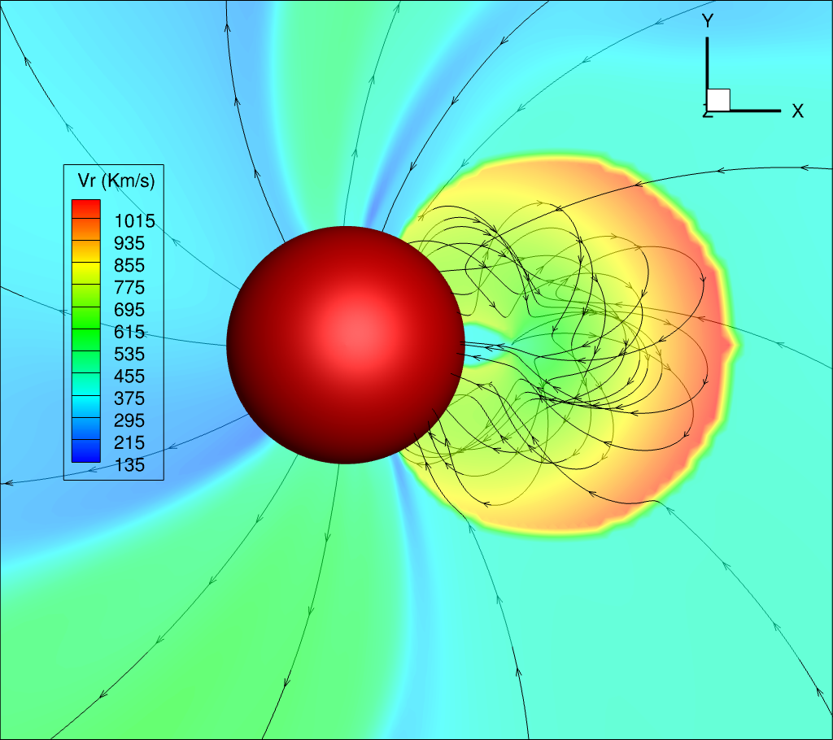
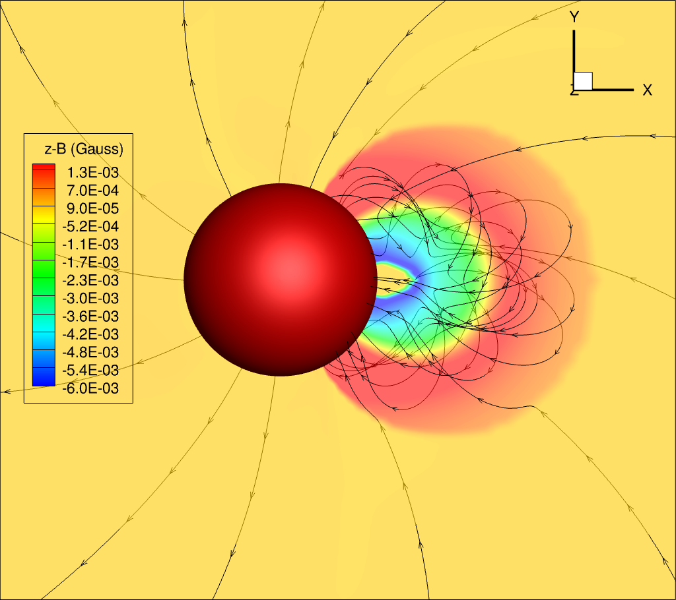
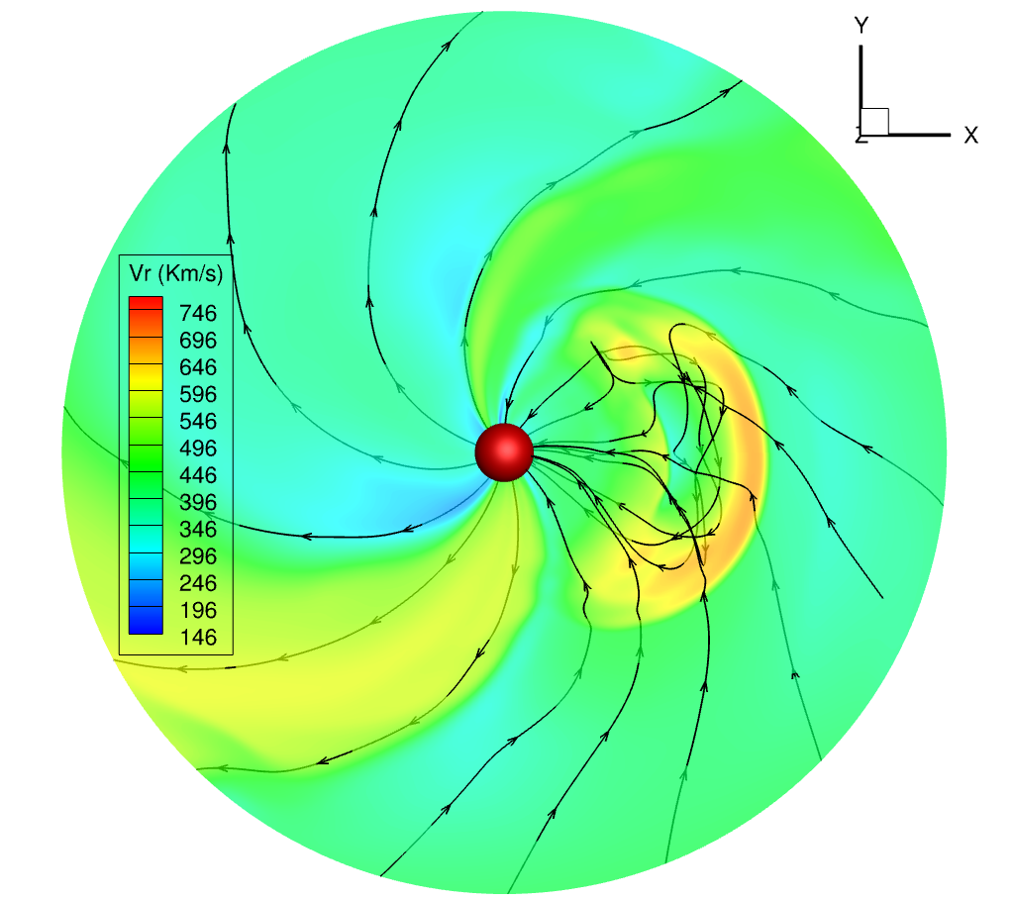
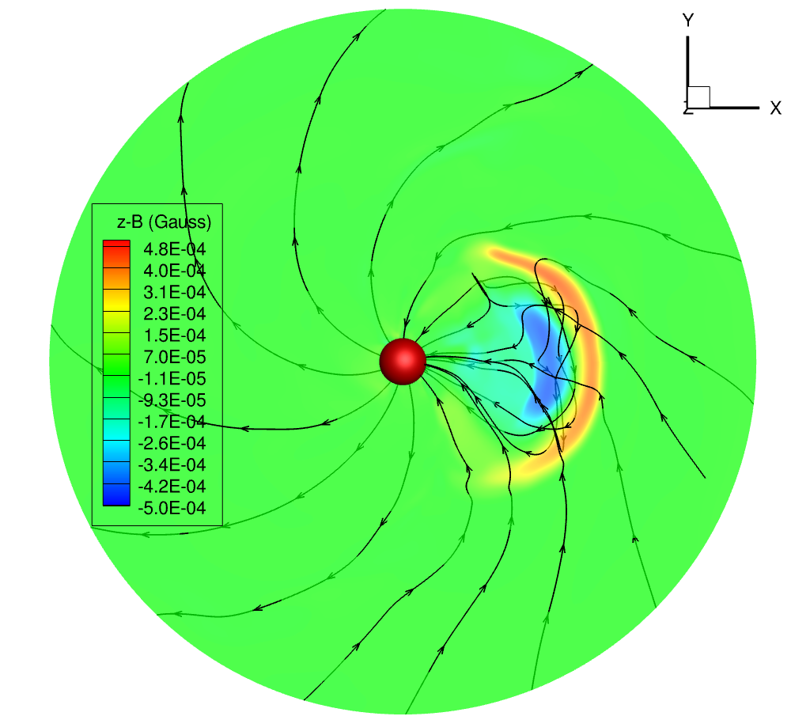
Using a constant turn flux rope model in CME simulations
The initial structure of the constant turn flux rope model
The flux rope 30 hours after the initial insertion
Singh et al 2022, submitted

Slide 5
Constraining model with observations
Speed: 1265 km/s
Direction: S12W08
Orientation: 53⁰
Aspect Ratio: 0.5
Half angle: 33⁰
Mass: 1.6 x 10¹⁶ gm
GCS fitting of 12 July 2012 CME (Singh et al 2020a)

Slide 6
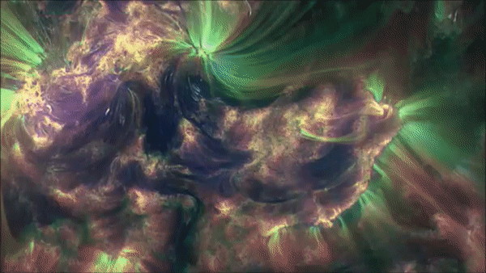
Constraining model with observations
CME flux rope eruption mechanism (Klein et al 2018)
Credit: NASA

Slide 7
12 July 2012 CME simulation
Arrival time error: ~1 hrs
Arrival time and magnetic field predictions are much more accurate than previous studies of the same event with different flux rope models and data constraining techniques (Shen et al 2014, Scolini et al 2019, Singh et al 2020)
Singh et al 2022, submitted

Slide 8
Quantifying Uncertainties
Speed: 1265 km/s
Direction: S12W08
Orientation: 53⁰
Aspect Ratio: 0.5
Half angle: 33⁰
Mass: 1.6 x 10¹⁶ gm
GCS fitting of 12 July 2012 CME (Singh et al 2020a)

Slide 9
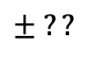
Quantifying Uncertainties
Speed: 1265 km/s
Direction: S12W08
Orientation: 53⁰
Aspect Ratio: 0.5
Half angle: 33⁰
Mass: 1.6 x 10¹⁶ gm
$$± ??$$
We estimated the subjective uncertainties in GCS speed, latitude, longitude, and orientation by comparing GCS fitting results of common CMEs in 6 catalogs and published lists of GCS fittings.
GCS fitting of 12 July 2012 CME (Singh et al 2020a)

Slide 10
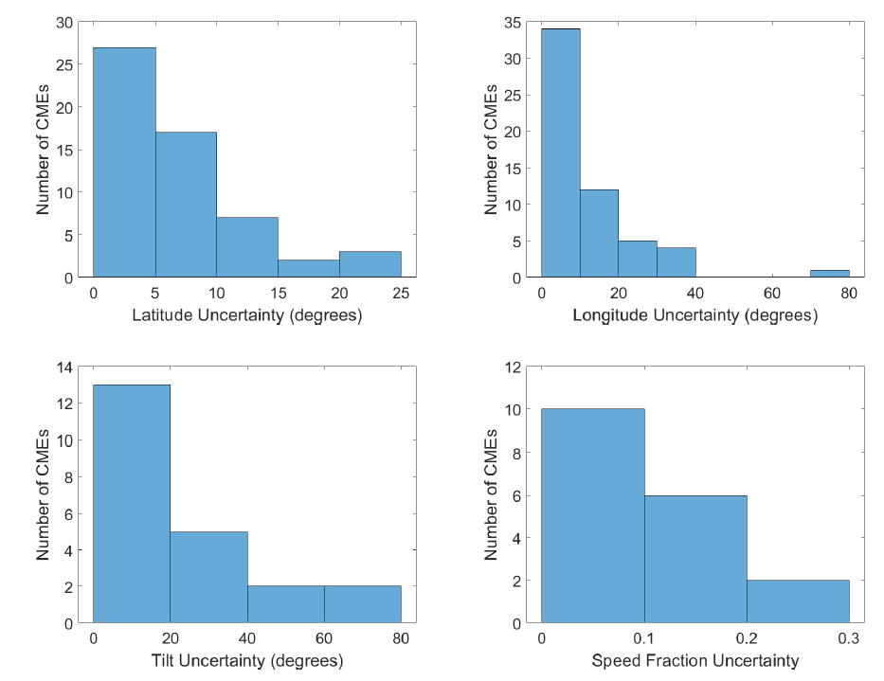
Ensemble modeling with GCS uncertainties
Singh et al 2022, submitted

Slide 11
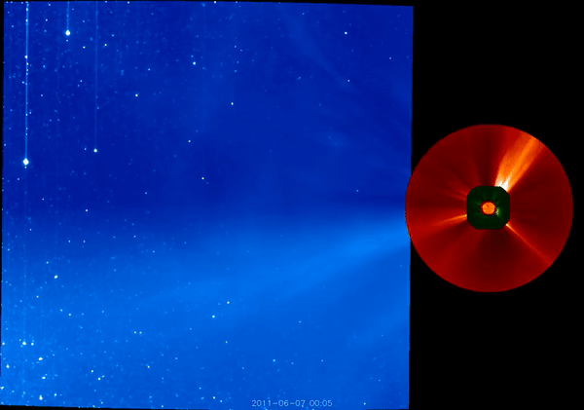
Using HI data to track ICMEs
Tracking of a CME in the heliosphere with heliospheric imagers (HI) onboard STEREO A. (Credit: NASA)

Slide 12
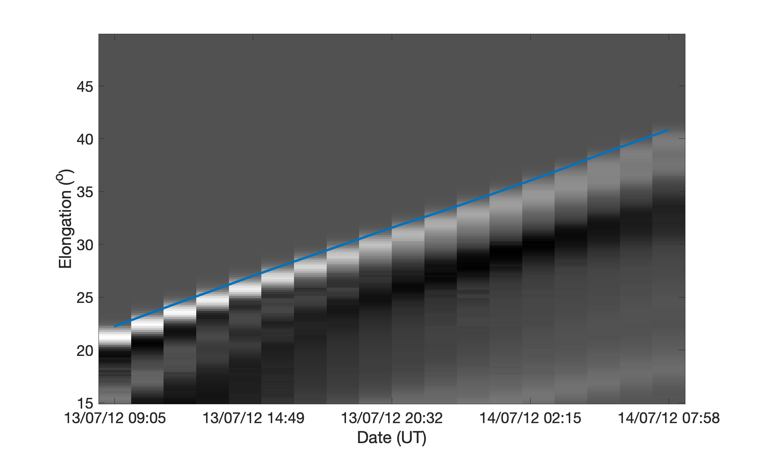
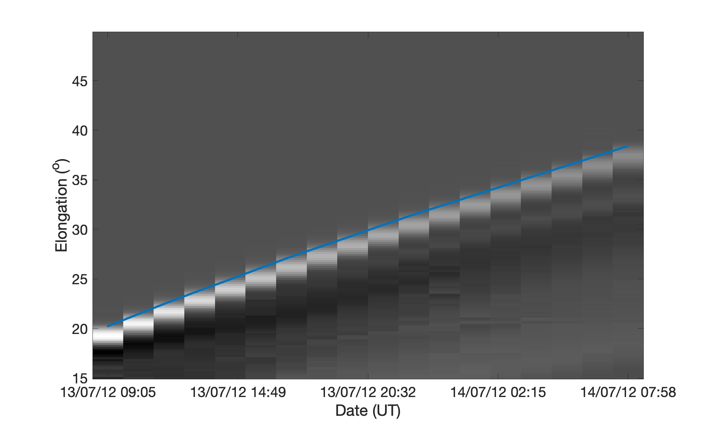
Using HI data to compare ensemble members with observations

Slide 13
Using HI data to compare ensemble members with observations
STEREO A
STEREO B

Slide 14
Using HI data to compare ensemble members with observations
STEREO A
STEREO B

Slide 15
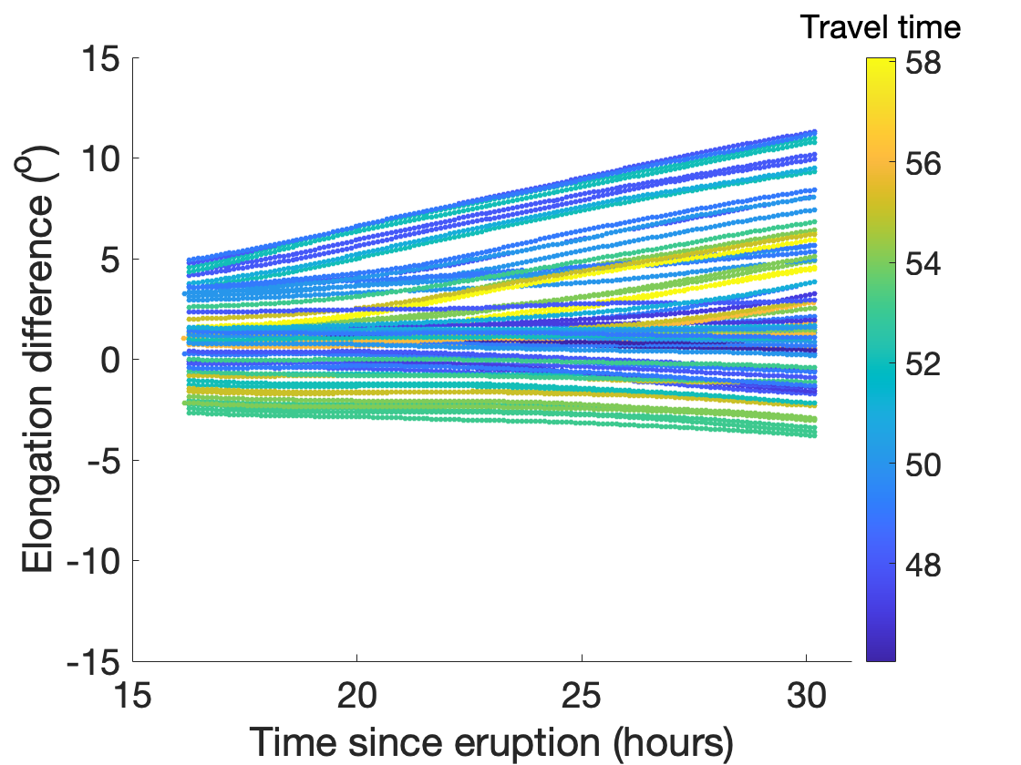
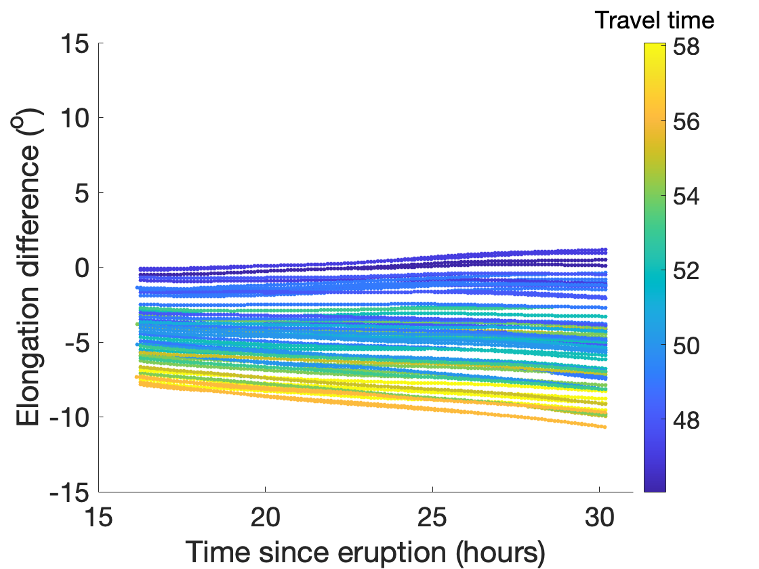
Using HI data to compare ensemble members with observations
STEREO A
STEREO B

Slide 16

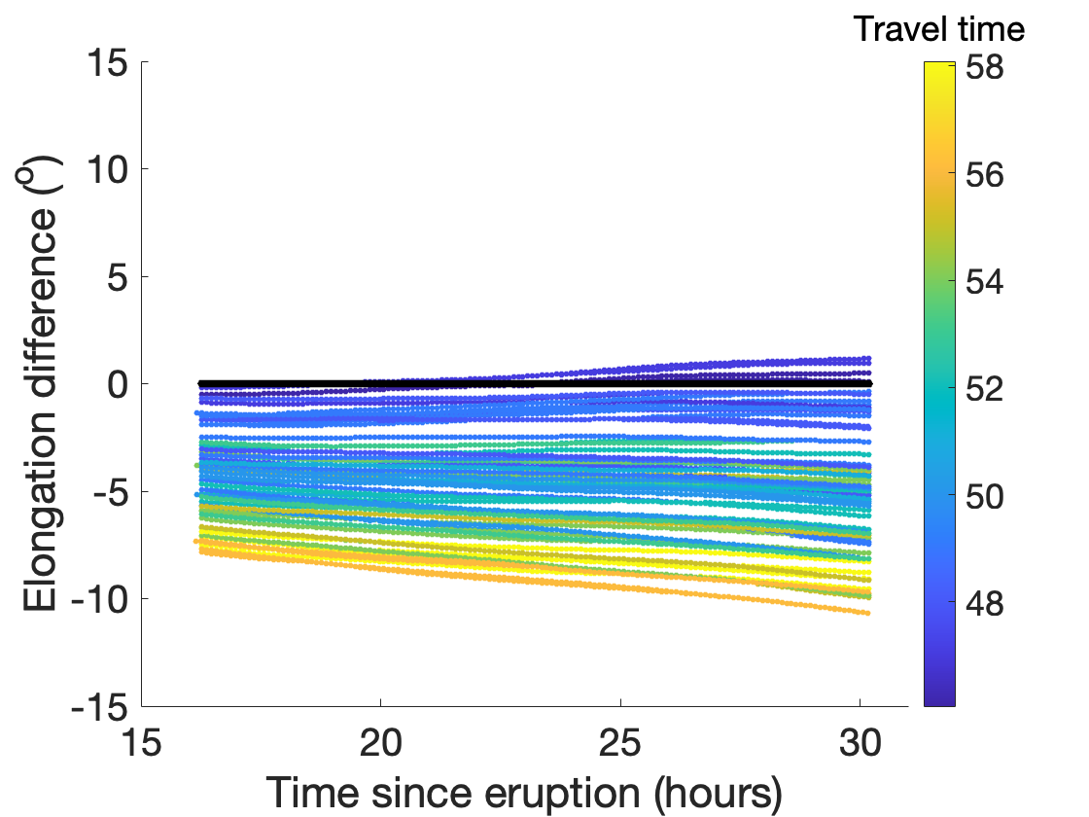
Using HI data to compare ensemble members with observations
STEREO A
STEREO B

Slide 17
Using HI data to compare ensemble members with observations
STEREO A
STEREO B
Results from holdout data

Slide 18
Results with Lasso regression
CME date | Absolute error in travel time of seed ensemble member | Absolute error in travel time with Lasso regression (Both STEREO A and B) | Absolute error in travel time with Lasso regression (Only STEREO A)
8/1/10 | 3.9 | 3.7 | 7.2
9/6/11 | 15.0 | 9.3 | 14.7
9/13/11 | 15.2 | 1.3 | 0.3
1/19/12 | 3.7 | 6.8 | 7.9
7/12/12 | 0.9 | 1.8 | 2.5
9/28/12 | 9.1 | 2.0 | 8.0
Average (MAE) | 8.0 | 4.1 | 6.8

Slide 19
Results with dense neural networks
CME date | Error in travel time of seed ensemble member | Absolute error in travel time with NNs (Both STEREO A and B) | Absolute error in travel time with NNs (Only STEREO A)
8/1/10 | 3.9 | 1.5 | 2.5
9/6/11 | 15.0 | 13.2 | 10.4
9/13/11 | 15.2 | 5.2 | 3.9
1/19/12 | 3.7 | 4.9 | 5.4
7/12/12 | 0.9 | 0.4 | 1.7
9/28/12 | 9.1 | 4.8 | 5.1
Average (MAE) | 8.0 | 5.0 | 4.8

Slide 20
Conclusions
The constant turn flux rope model can be used to perform data constrained simulations of the CMEs in the inner heliosphere.
The arrival time predictions with only seed ensemble member had mean absolute error (MAE) of 8 hr for our 6 considered CMEs.
This error is better than the currently used models with tend to have MAE > 12 hr (Riley et al 2017)
The MEA can be further improved by comparing ensemble members with HI data.
Lasso regression improved MAE to 4.1 hr when using both STEREO A and STEREO B HI data.
Lasso regression improved MAE to 6.8 hr when using only STEREO A HI data.
NNs improved MAE to 5.0 hr when using both STEREO A and STEREO B HI data.
NNs improved MAE to 4.8 hr when using only STEREO A HI data.
Therefore, this method can be used for downstream updating of the CME arrival time predictions.

Slide 21
Conclusions
The constant turn flux rope model can be used to perform data constrained simulations of the CMEs in the inner heliosphere.
The arrival time predictions with only seed ensemble member had mean absolute error (MAE) of 8 hr for our 6 considered CMEs.
This error is better than the currently used models with tend to have MAE > 12 hr (Riley et al 2017)
The MEA can be further improved by comparing ensemble members with HI data.
Lasso regression improved MAE to 4.1 hr when using both STEREO A and STEREO B HI data.
Lasso regression improved MAE to 6.8 hr when using only STEREO A HI data.
NNs improved MAE to 5.0 hr when using both STEREO A and STEREO B HI data.
NNs improved MAE to 4.8 hr when using only STEREO A HI data.
Therefore, this method can be used for downstream updating of the CME arrival time predictions.
Thank You!

